Slide 1
HISTORY OF OPERATING SYSYTEM
By:
Abishek. A

Slide 2
Evolution of operating systems
The first computers used batch operating systems, in which the computer ran batches of jobs without stop.
Programs were punched into cards that were usually copied to tape for processing.
When the computer finished one job, it would immediately start the next one on the tape.
Users dropped jobs off, then returned to pick up the results after their jobs had run.
This was inconvenient for the users, but the expensive computer was kept busy with a steady stream of jobs.

Slide 3
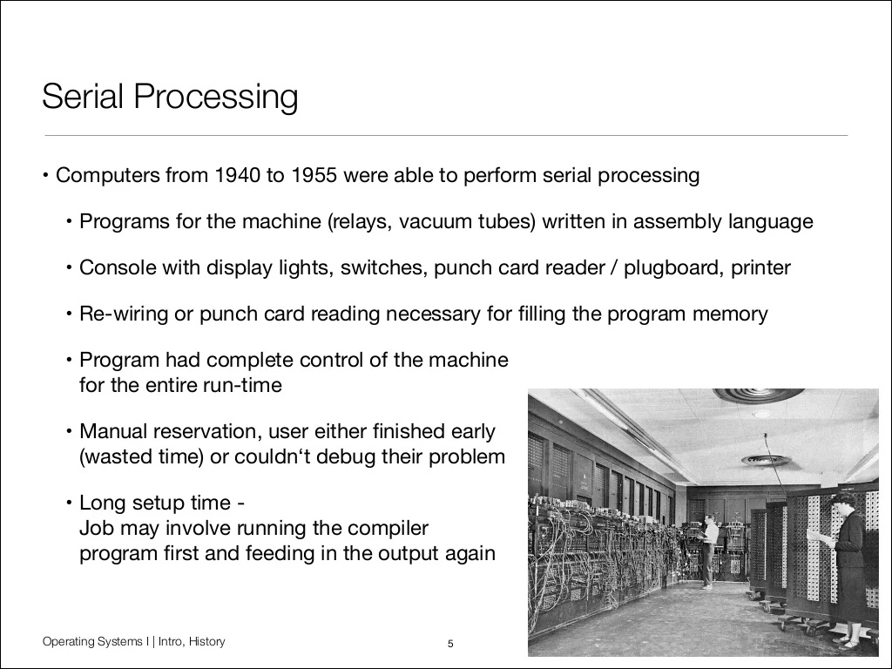

Slide 4
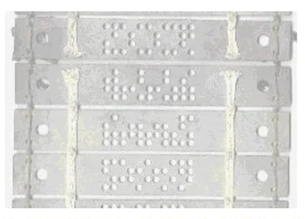
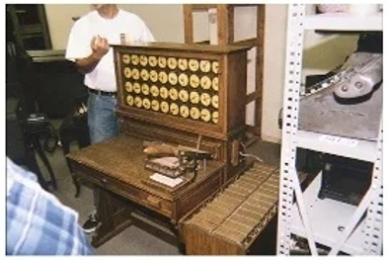
Punch card

Slide 5
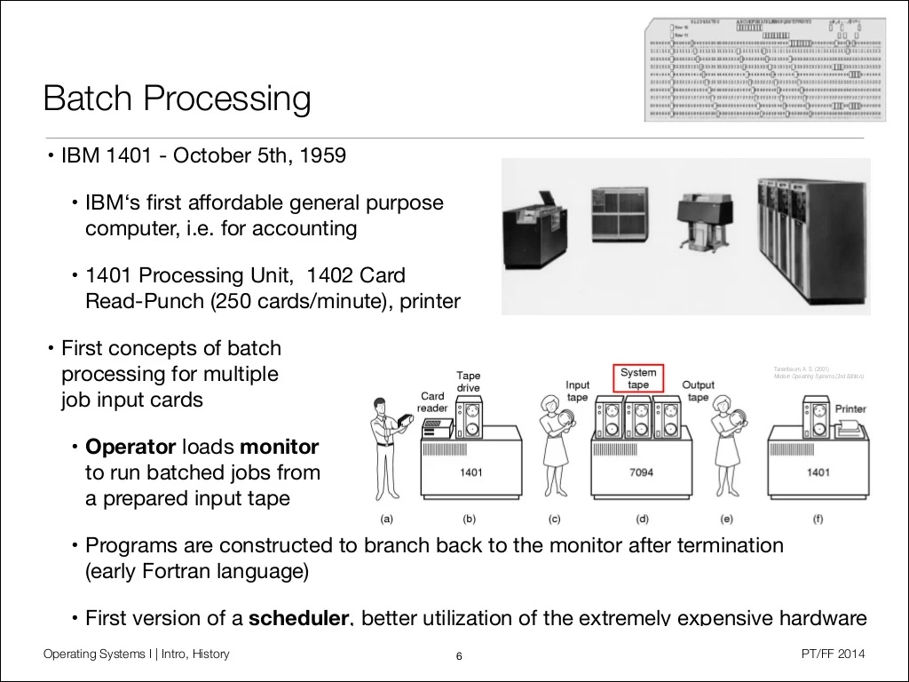

Slide 6
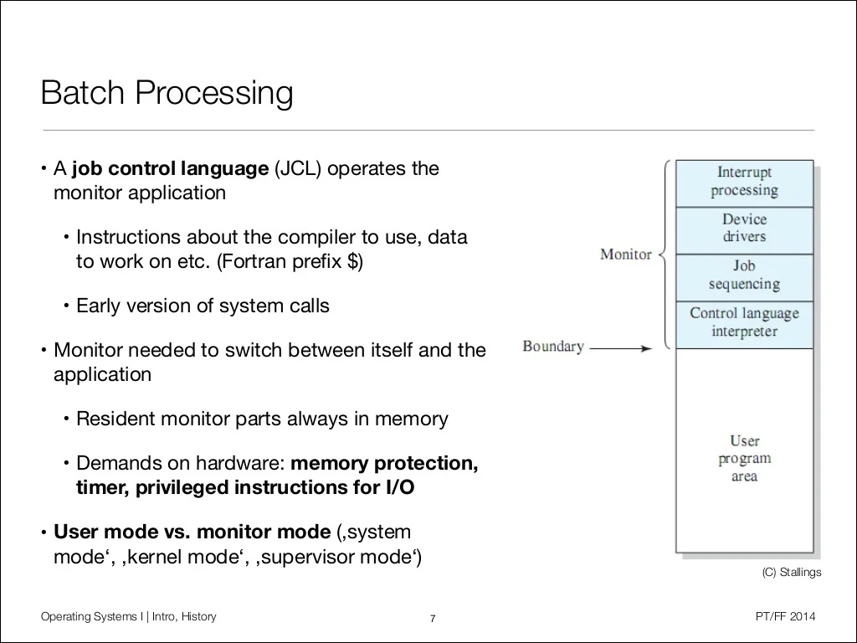

Slide 7
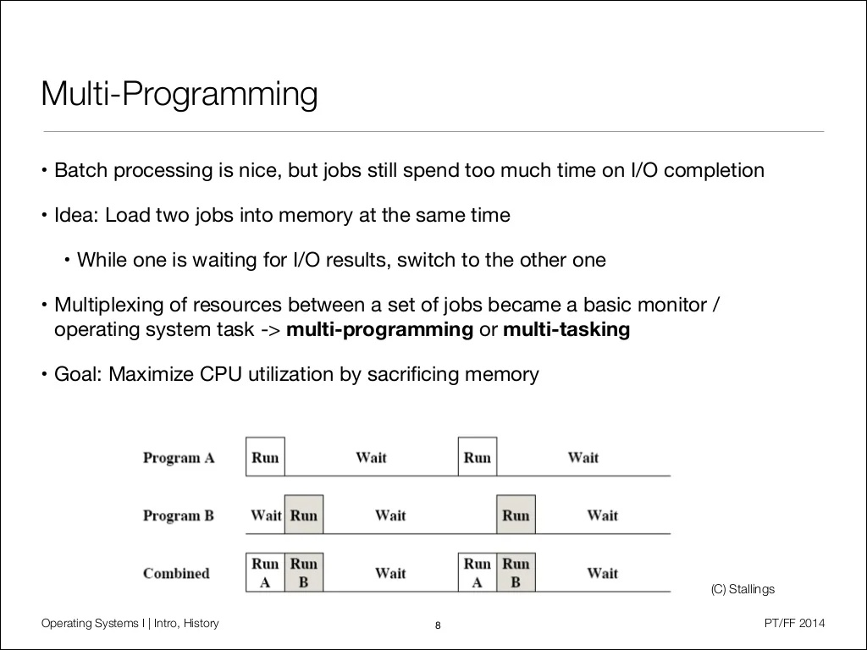

Slide 8
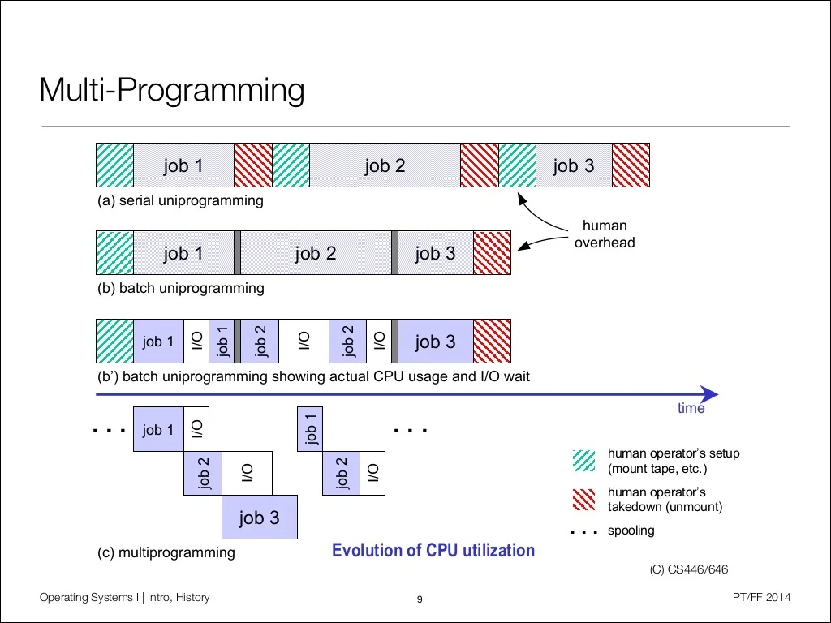

Slide 9
Requirements for Multiprogramming
Hardware support
Memory management
Memory protection (data and programs)
Software support from the OS:
For scheduling (which program is to be run next).
To manage resource allocation.

Slide 10
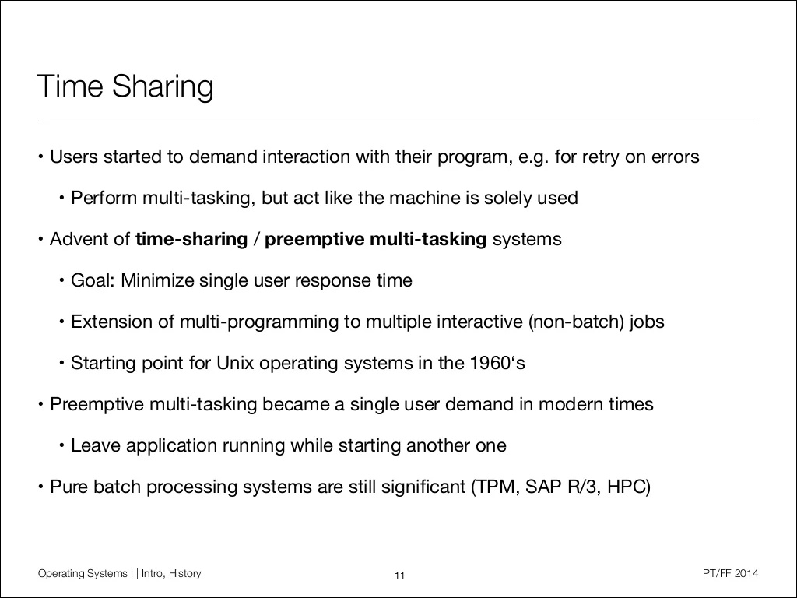

Slide 11
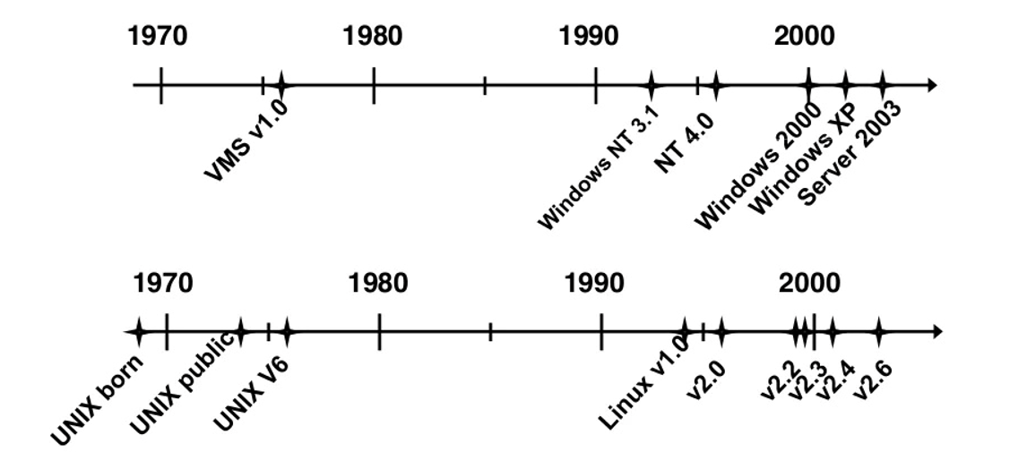
Windows and Linux Evolutions
Windows and Linux kernels are based on foundations developed in the mid- 1970s.

